Slide 1

Chat Deployment with IBM Cloud Watson Assistant

Slide 2
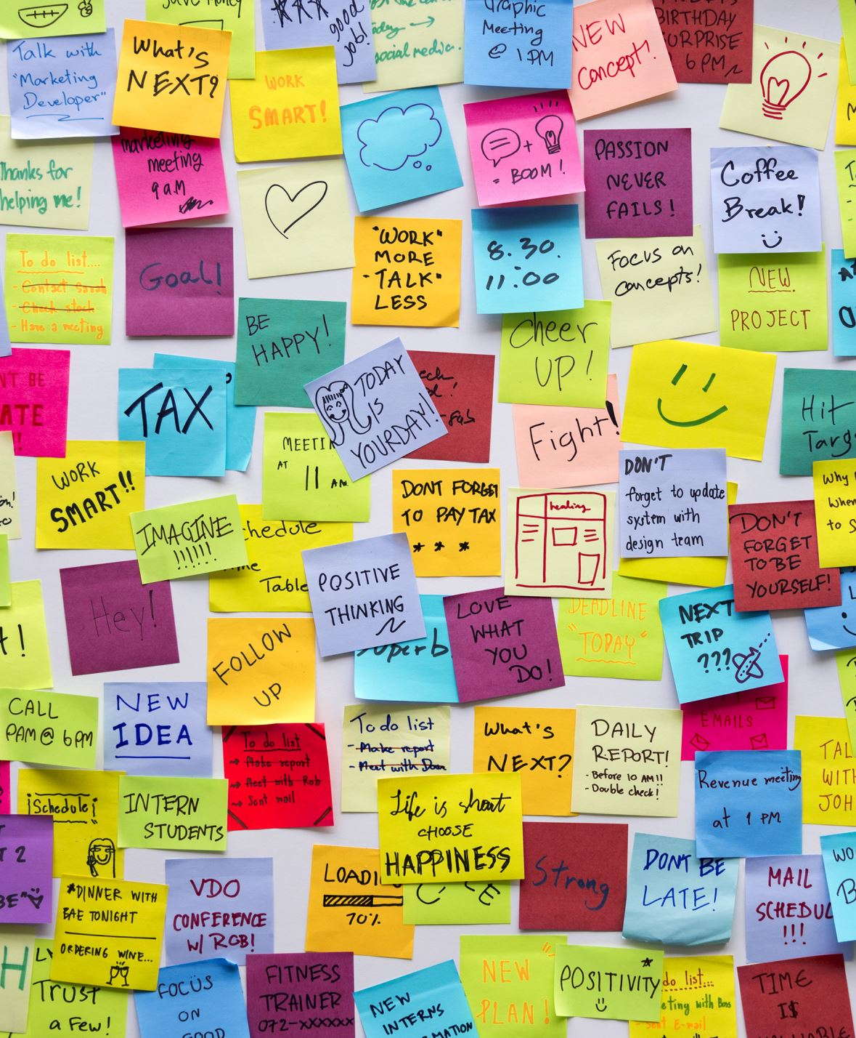
INTRODUCTION
This dataset include JSON file and cloud Watson Assistant made for University chatbot so it contain information about University Inquiry for ordinary puprose. In this file contains list of intents with tags, pattern, reponses and context set. The file include 38 intents or called tags.This dataset can be used for training and evaluating chatbot models.

Slide 3
To add tags you have to write one important word which included in your every questions or pattern asked by user so that by tag chatbot gives you appropriate answers. For instance, If you want to add questions about fees then your tag name must be fees and for how many hour your collage opens or time of your university then your tag name should be hours. However, this file contains many tags like greetings, fees, numbers, hours, events, floors, canteens, hod, admission and many more. The patterns refers to the questions which you want to include and which you think that user might be ask during their inquiry. The response category filled up by you your response which you want to give to user if they ask any queries. Last, The context_set field is left empty in this case, but it could be used to specify a particular context in which a given intent should be used.

Slide 4

USAGES
There are just a few examples of the many ways that chatbots can be used:
Education: Chatbots can be used in education to provide students with personalized learning experiences, answer questions about coursework, and provide feedback on assignments.
Customer Service: Chatbots can be used to provide customer service support 24/7. They can answer frequently asked questions and provide personalized assistance to customers.
Healthcare: Chatbots can be used to provide medical advice, schedule appointments, and help patients manage their health.
Banking: Chatbots can be used in the banking industry to help customers with their accounts, answer questions about transactions, and provide information about bank products.
Travel: Chatbots can be used in the travel industry to help customers with booking flights, hotels, and rental cars, as well as answer questions about travel destinations.
Human Resources: Chatbots can be used in human resources to help employees with their benefits, answer questions about company policies, and provide information about job openings.
E-commerce: Chatbots can help customers with product recommendations, track orders, and process payments. They can also provide product information and answer questions.

Slide 5
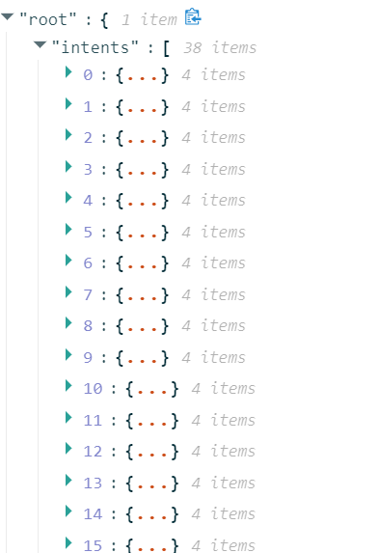
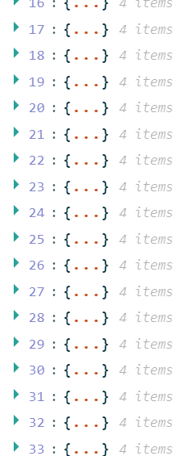
intens.json file: This intent file have 38 intents with 4 list called tags, patterns, reponses and context_set.
Categories: Tags: Header of intent Patterns: User input(Queries) Responses: Chatbot output for user queries.(Answers) Context_set(optional): Specify the context in which intent should be used.

Slide 6

CONTEXT
The Botpress Montreal Hotel and Suites dataset is a knowledge-based chatbot question and answering dataset, annotated by humans to check the quality of the results. It consists of the responses provided by various chatbot engines for various questions given a knowledge base to the chatbot engine.

Slide 7

DATASET
our unique chatbots were developed using 4 of the well-known chatbot developer platforms - Botpress' OpenBook, Rasa, Google Dialogflow, and IBM Watson Assistant, for an imaginary hotel based in Montreal.

Slide 8
FILES
BP_MHS_V1.csv - contains the annotated data with questions, responses, and their corresponding annotations. The factsheet for the knowledge base provided to the chatbot engines can be downloaded here

Slide 9
DATA
There are 5000+ unique questions provided to each of the chatbot engines and their responses were recorded. The responses were annotated across 12 parameters that determine the quality of the responses. There were two rounds of annotations. Following is a brief description abo the columns in the dataset

Slide 10
qid (string) - Unique Id for a question
question (string) - Text provided as a question to the chatbot
related_facts (string) - Fact(s) that are related to the question's response from the knowledge base
answer_in_fact (boolean) - If the answer is available in the fact
engine (string) - Name of the engine used
engine_response (string) - Response provided by each engine
p1 (boolean) - Response had excessive information [true, if applicable]
p2 (boolean) - Response had information that's unrelated [true, if applicable]
p3 (boolean) - Response contained falsehoods [true, if applicable]
p4 (boolean) - Response was not correct [true, if applicable]
p5 (boolean) - Response was partially correct [true, if applicable]

Slide 11
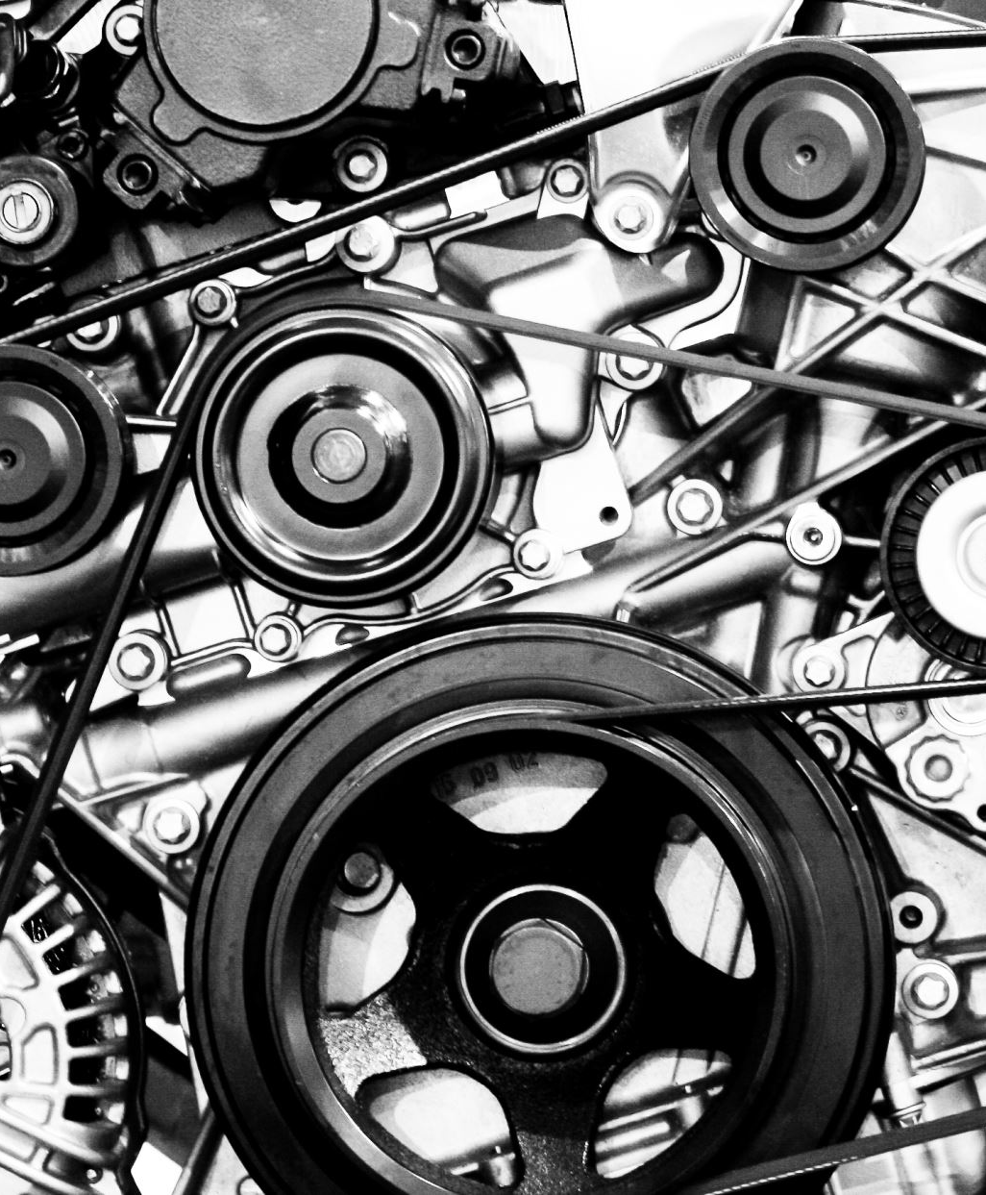
p6 (boolean) - Response was fully correct [true, if applicable]
p7 (boolean) - Engine said that it did not know the answer when it should have answered [true, if applicable]
p8 (boolean) - Response was that the engine did not understand the question [true, if applicable]
p9 (boolean) - Engine correctly said that it did not know the answer [true, if applicable]
p10 (boolean) - Question was deemed invalid [true, if applicable]
best (boolean) - Out of the responses from four engines for each question, the best response(s) [true, if applicable]
worst (boolean) - Out of the responses from four engines for each question, the worst response(s) [true, if applicable]
annotation_round (boolean) - The round number for annotation [with values of 1 or 2 for their respective round]

Slide 12

import ibm_watson
from ibm_watson import TextToSpeechV1
from ibm_cloud_sdk_core.authenticators import IAMAuthenticator
# Set up the Watson Text to Speech service
apikey = 'YOUR_API_KEY'
url = 'YOUR_API_URL'
authenticator = IAMAuthenticator(apikey)
text_to_speech = TextToSpeechV1(
authenticator=authenticator
)

Slide 13
import ibm_watson
from ibm_watson import TextToSpeechV1
from ibm_cloud_sdk_core.authenticators import IAMAuthenticator
# Set up the Watson Text to Speech service
apikey = 'YOUR_API_KEY'
url = 'YOUR_API_URL'
authenticator = IAMAuthenticator(apikey)
text_to_speech = TextToSpeechV1(
authenticator=authenticator
)

Slide 14
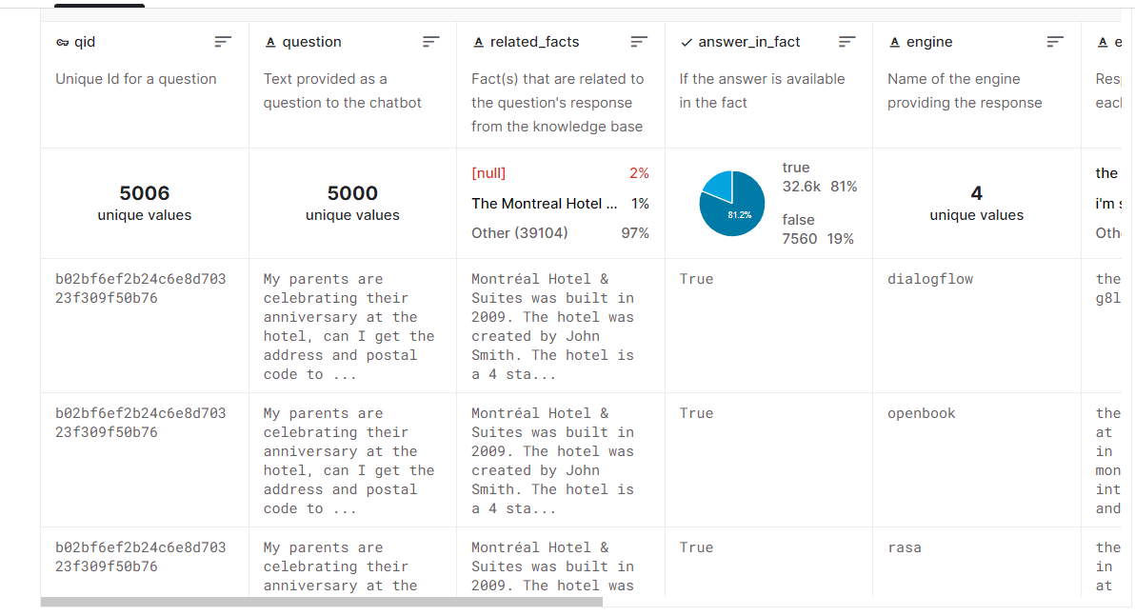

Slide 15
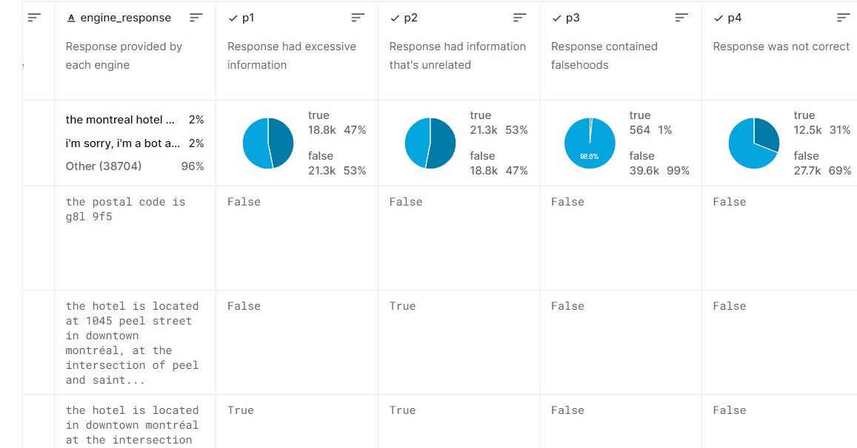

Slide 16
